Slide 1
Lung Adenocarcinoma Literature Presentation
Lilly Jiang, Kaining Feng, Alex Zhang, Riddhee Mehta
1

Slide 2
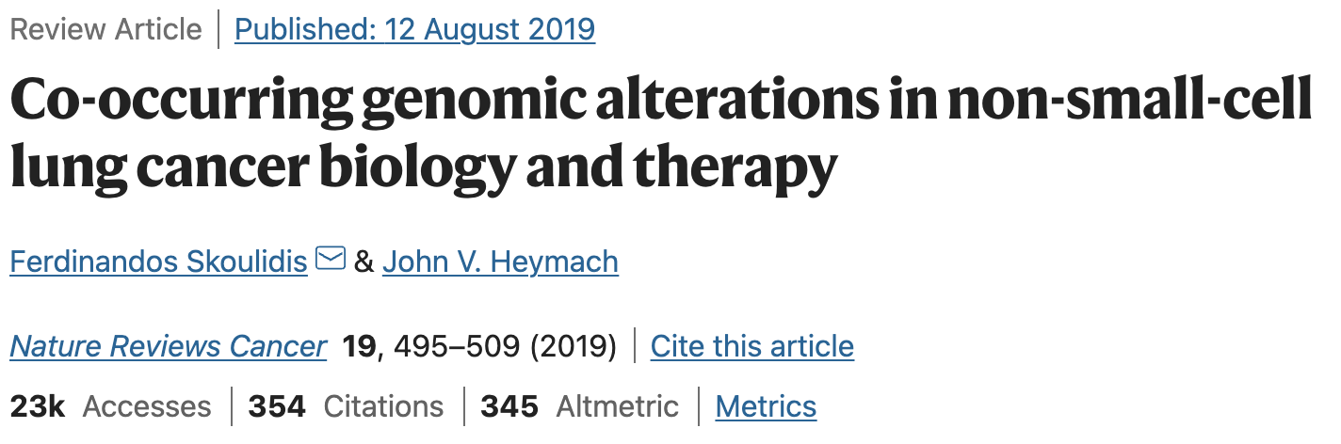
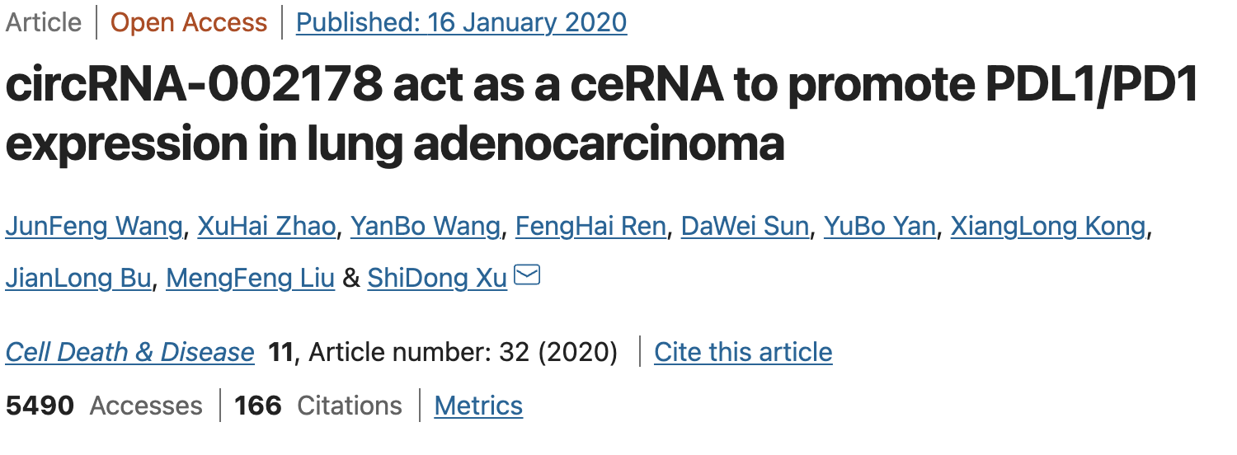
-Omics
Omics:
Genomics.
Omics:
Genomics, transcriptomics.
2

Slide 3
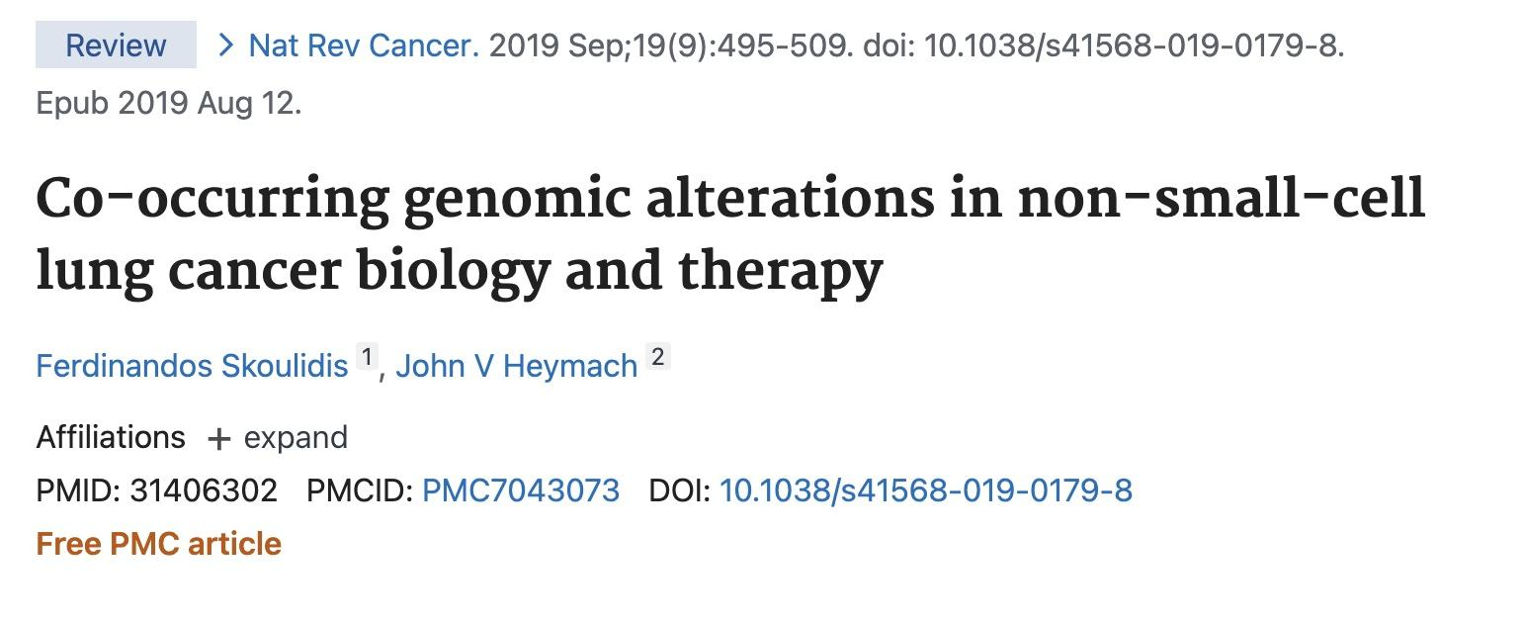
Review Paper
Goals:
Discuss the impact of co-occurring genomic alterations on non-small-cell lung cancer
Assess the challenges/opportunities they present for personalized anti-cancer therapy & precision immunotherapy
Methodology:
Pathogenesis
Biology
Microenvironmental interactions
Therapeutic vulnerabilities
3

Slide 4
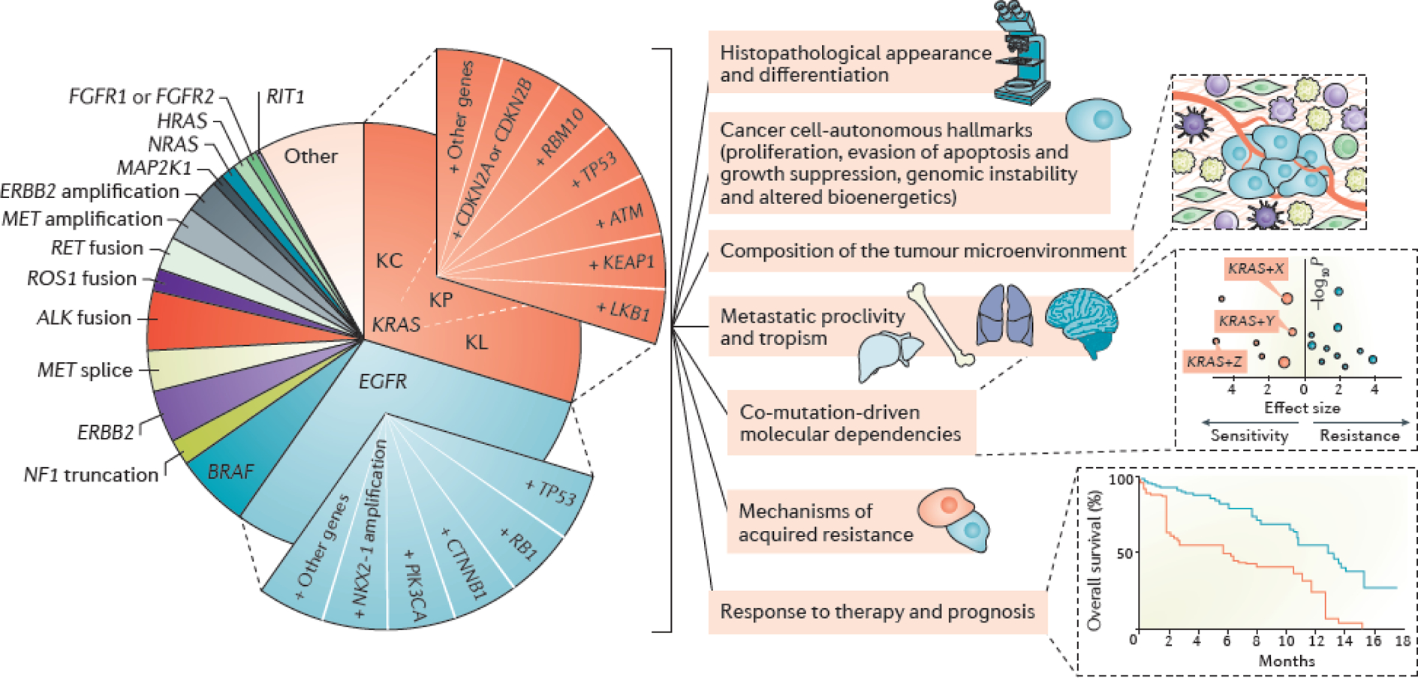
Review Paper
Main findings:
Co-occurring genomic alterations in oncogenic drivers and tumor suppressor genes significantly make up the molecular diversity of NSCLC
Proposal of a new model for the molecular classification of NSCLC that encompasses these factors
Development of improved clinical response prediction algorithms and personalized therapeutic approaches
4

Slide 5
Research Paper
Hypothesis:
circRNA-002178 could act as a ceRNA to promote PDL1/PD1 expression in lung adenocarcinoma.
Goals
To compare the circRNA expression profiles of LUAD tissue with that of non-cancerous tissue.
To study the effects of circRNA on PDL1/PDL expression in LUAD.
Methodology
The serum samples from 30 healthy volunteers and 120 LUAD patients without any treatment were collected at the Harbin Medical University Cancer Hospital
5

Slide 6
Research Paper
Methodology continued
circRNA expression profile data obtained from GEO database.
Cultured the cell, isolate the exosome from serum, and incubate exosomes with CD8+ T cells
RNA extraction using TRIzol reagent and manipulation
Expression and statistical analysis: The Mann–Whitney U-test was used to compare significant differences in exosomal circRNA expression between the LUAD patients and healthy volunteers; Receiver operating characteristic curve (ROC) analysis was utilized to estimate the diagnostic value of exosomal circRNA (significant: P<0.005)
6
Notes:
alex

Slide 7
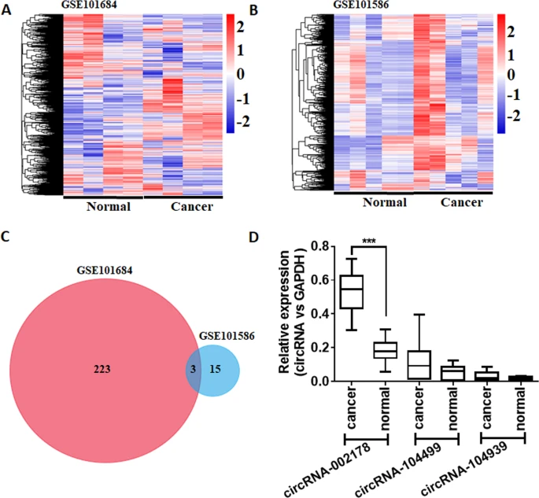
Research Paper
Main findings:
circRNA-002178 was highly expressed in LUAD tissues.
circRNA-002178 enhanced PDL1 expression through the absorption of miR-34a.
Enhanced PD1 expression by absorption of miR-28-5p in CD8+ T cells.
The exosomal circRNA-002178 significantly upregulated in the serum from LUAD patients.
circRNA-002178 also exist in exosomes and can be used as a new diagnosis biomarker for LUAD.
7
Notes:
alex

Slide 8
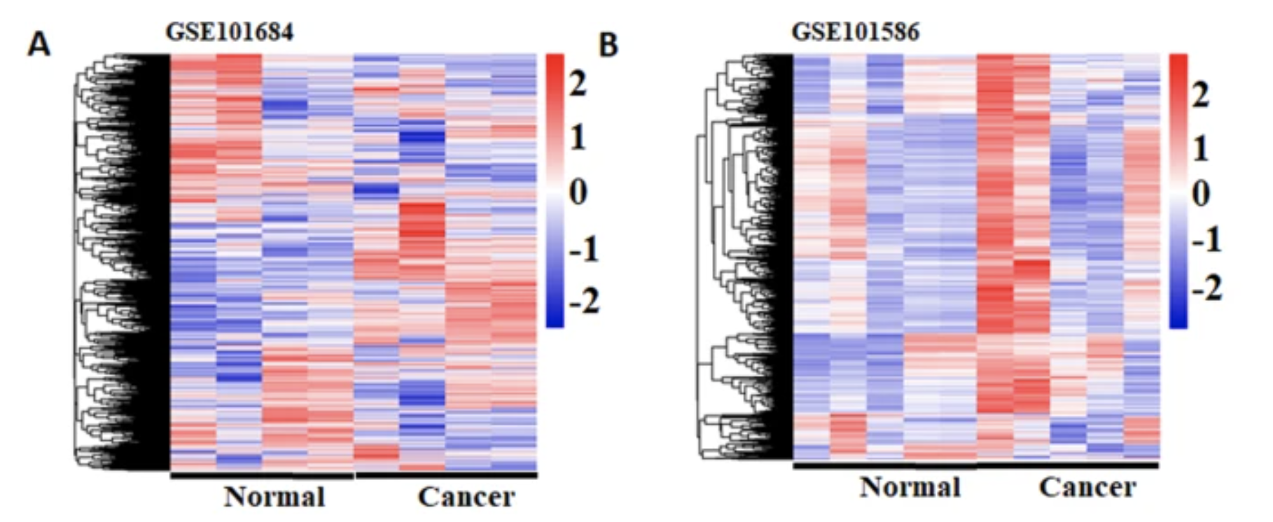
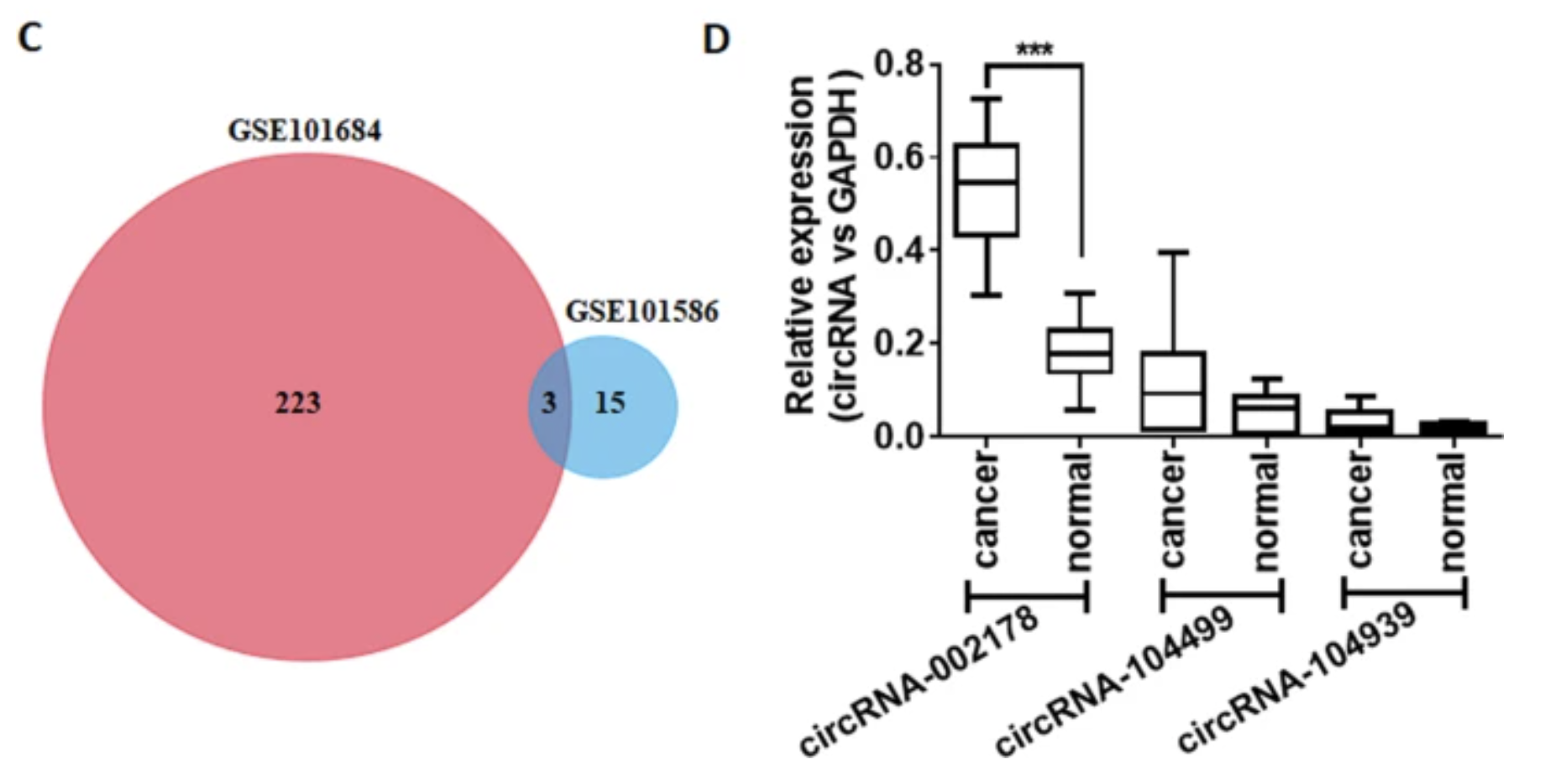
Figures
8
Notes:
What data is being used? What does this figure mean? Why did the authors choose this method of displaying the data? Do you agree?

Slide 9
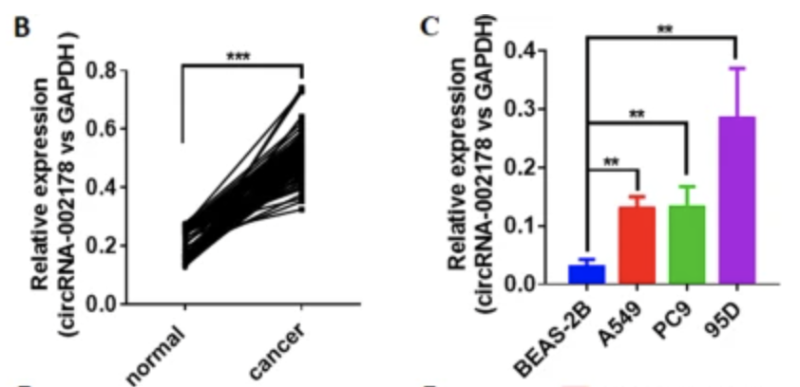
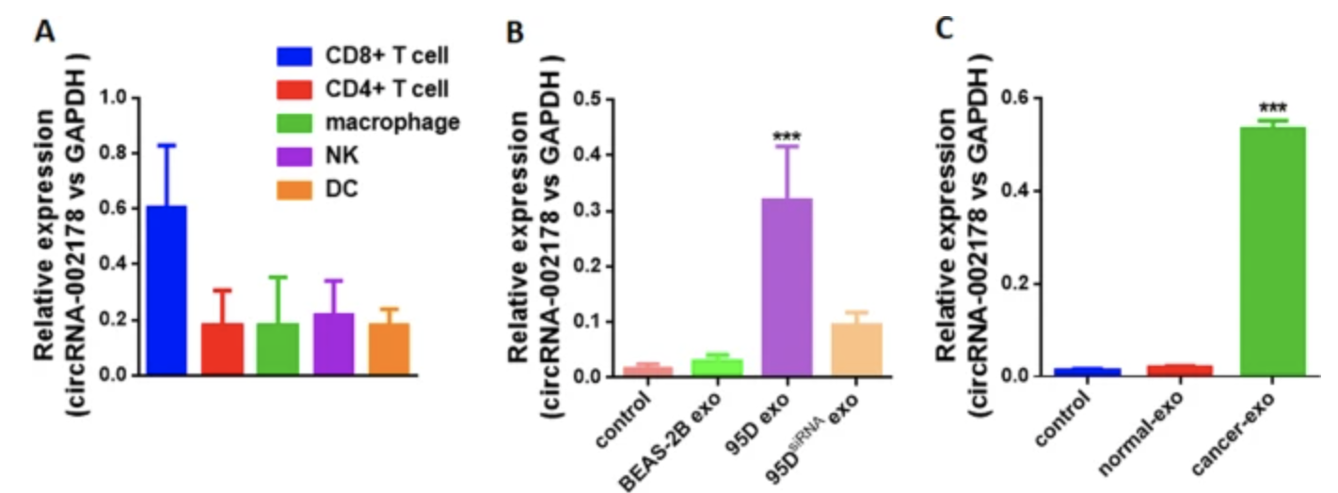
Figures
9
Notes:
What data is being used? What does this figure mean? Why did the authors choose this method of displaying the data? Do you agree?

Slide 10
Questions
What new model could be proposed that can more precisely target the effects of co-occurring genomic alterations on NSCLC?
What’s the difference between RT-PCR and qRT-PCR?
Is there any limitation of circRNA-002178 as a potential non-invasive biomarker for the LUAD detection?
10
Notes:
Does anyone else have questions?
How related

Slide 11
Citations
Skoulidis, F., Heymach, J.V. Co-occurring genomic alterations in non-small-cell lung cancer biology and therapy. Nat Rev Cancer 19, 495–509 (2019). https://doi.org/10.1038/s41568-019-0179-8
Wang, J., Zhao, X., Wang, Y. et al. circRNA-002178 act as a ceRNA to promote PDL1/PD1 expression in lung adenocarcinoma. Cell Death Dis 11, 32 (2020). https://doi.org/10.1038/s41419-020-2230-9
11

